Slide 1
The Intracranial Joint
Arnold Little II
Vertebrate Morphology
Dr. Henry Bart
A mystery in the evolution of tetrapods

Slide 2
One of the key elements in studying vertebrate evolution lies in the changing jaw and cranial structure of fishes and lower vertebrates. These changes coincide with the diet and needs for homeostasis of organisms. Most structural changes in the jaw and head region are easily explained by a particular change in the lifestyle of the evolving vertebrates. An exception to these logical changes is the sudden loss of the intracranial joint from fishes to tetrapods. This evolutionary development has perplexed scientists and evolutionary experts because the biological purpose of the loss of the intracranial joint is an enigma.

Slide 3
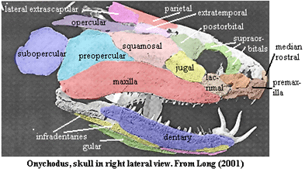
Intracranial Joint
The Intracranial Joint is a complete division running through the braincase and separating the nasal organs and eye from the ear and the brain. Once common in frogs, the intracranial joint serves as a hinge that allowed the anterior chondrocranium to move relative to the posterior chondrocranium;raise upper jaw while lowering bottom jaw. Presently, the coelacanth is the only living organism with an intracranial joint.

Slide 4
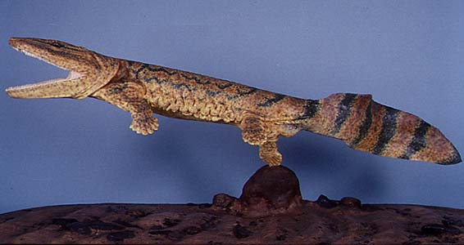
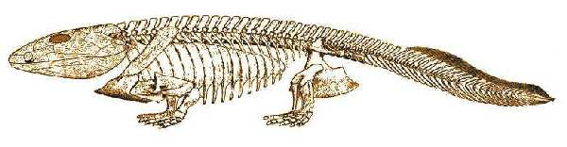
Eustenopteron
Ancanthostega
The intracranial joint is present in the fish Eustenopteron and absent in the earliest tetrapod Ancanthostega. This suggests some significance of the intracranial joint in the evolution of vertebrates and land dwelling animals. However, the biological significance of the intracranial joint remains obscure.

Slide 5
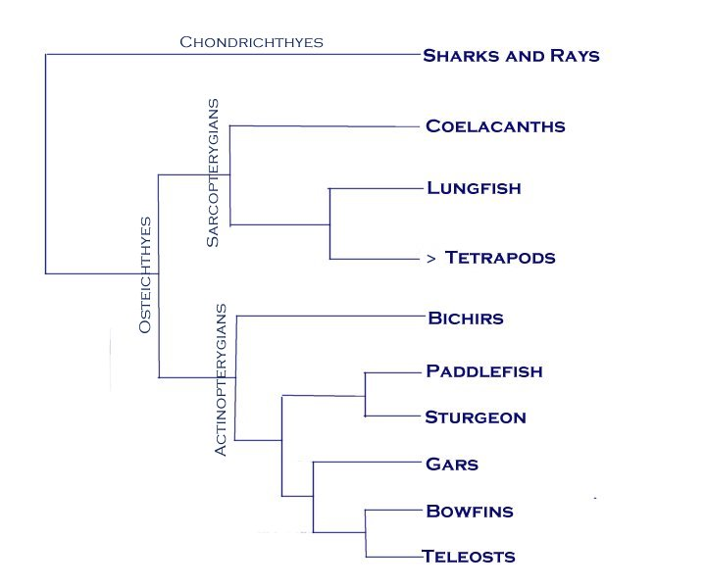
The coelacanth is the only clue left to solve the mystery of the biological and evolutionary significance of the intracranial joint. The coelacanth is a member of the subclass Sarcopterygia (lobe-finned fishes) of class Osteichthyes (bony fishes).

Slide 6
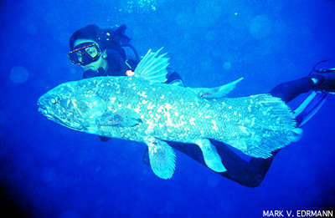
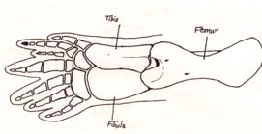
The fleshy fins of the coelacanth are thought to be the precursors to tetrapod limbs. They have been called the missing link between finned fishes and four-legged amphibians. Coelacanths arose in fossil evidence almost 400 million years ago and were thought to be extinct until 1938. Recent finding of a coelacanth

Slide 7
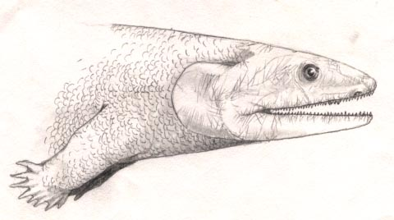
The homology that exists between coelacanth lobed-fins and tetrapod limbs is an indication of the coelacanth’s role in the evolutionary process. However, it is not clear why the intracranial joint was so rapidly lost from coelacanths to tetrapods. It is possible that there is no special evolutionary significance associated with the intracranial joint, but the converse possibility has sparked the interest of scientists.

Slide 8
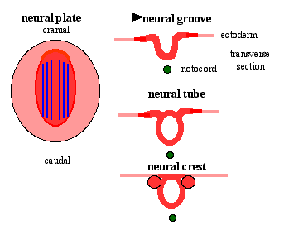
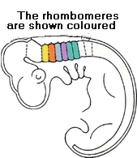
Flexion of the intracranial joint is likely responsible for the initiation of jaw closure during feeding. Jenny Clack hypothesized that the rapid loss of the intracranial joint was caused by a rapid increase in neural crest contribution to the skull. In fish, the neural crest would contribute to components anterior to the intracranial joint. In the early tetrapod, the neural crest extends posteriorly, including elements ventrolateral to the ear.
Neural crest contribution in vertebrates

Slide 9
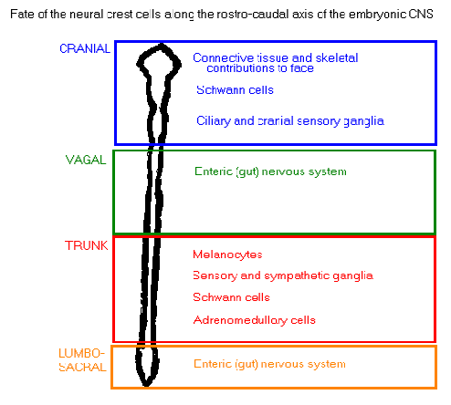
Following their migration, neural crest cells differentiate into a wide variety of cell types throughout the body. Neural crest cells give rise to most of the peripheral nervous system, facial skeleton and other derivatives throughout the embryo. Perhaps Clack’s theory is accurate. Loss of the intracranial joint might have been a result of the tradeoff between a wider gape and an advanced nervous system.

Slide 10
In 1999, a 400 million year old fossil of the gnathostome, Psarolepsis was found in China. The fossil has sarcopterygian, actinopterygian, placoderm, and acanthodian features. This fossil lacks an intracranial joint. Therefore, if it is eventually classified as a basal osteichthyan, the presence of an intracranial joint can no longer serve as a defining characteristc of sarcopterygians. A critical issue is whether Psarolepsis has the typical sarcopterygian monobasal articulation of the paired fins. More on this

Slide 11
For now, the intracranial joint continues to stifle scientists. Why did tetrapods lose the intracranial joint? Perhaps Clack is on the right track with her neural crest hypothesis. Maybe the wide gape allowed by the intracranial joint would create balance problems for tetrapods. Maybe the intracranial joint was lost so suddenly because we would look funny with “pac-man jaws.” At any rate, the mystery of the sudden loss of the intracranial joint has yet to be solved.

